Slide 1
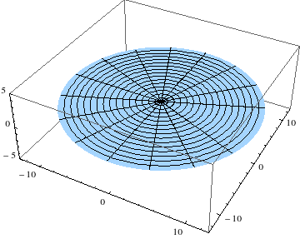
Circular membrane
13th November 2018

Slide 2
Laplacian polar coordinates
Since we want to discuss the vibration of circular membranes, the most suitable Laplacian in the wave equation has to be described in Polar coordinates.
We only consider a membrane of radius R and determine the solution φ(r,t) that are radially symmetric.
The wave equation becomes
And the boundary condition stating that φ(R,t) = 0 at all times
http://zeta.math.utsa.edu/~gokhman/courses/mat3623/Membrane.pdf
Notes:
The boundary condition means that the membrane is fixed along the boundary circle r = R.

Slide 3
Solution of the wave equation : Bessel’s equation
Using the method of separation of variables, we first determine solution φ(r,t) =R(r)T(t).
Substituting φ and its derivatives back into the wave equation and arrange the expression as follows
Note that dots denote derivatives with respect to t and primes denote derivatives with respect to r.
The expressions on both sides must equal a constant. This gives two linear ODEs,

Slide 4
General form of Bessel’s equation
This is a general form of Bessel’s equation
Complete solution of the Bessel’s equation is given as
Where ν is the order of the equation
J_{ν} is the Bessel’s function of the 1st kind order ν
Y_{ν} is the Bessel’s function of the 2nd kind order ν
and C and D are arbitrary constants.

Slide 5
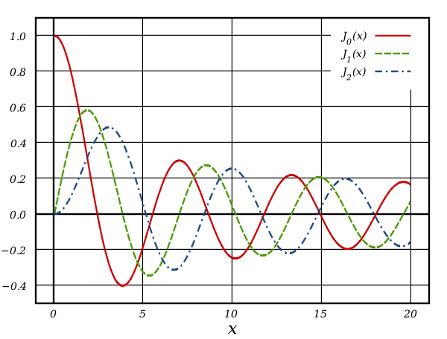
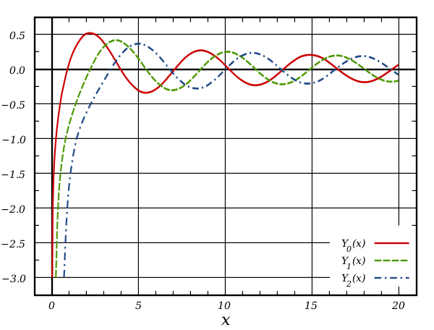
Bessel functions
Bessel’s function of the 1st kind
Bessel’s function of the 2nd kind
http://www.wikiwand.com/en/Bessel_function

Slide 6
Solution of the linear ODE
Recall the linear ODE eq. (2)
We can reduce (2) to Bessel’s equation if we set s = kr. Then 1/r = k/s and, keeping the notation R for simplicity.
By substituting this into eq. (2) and omitting the common factor k² we have

Slide 7
Bessel’s equation
This is clear that eq.(3) corresponds to the expression of the Bessel’s equation with parameter ν = 0.
Solutions of eq. (3) are Bessel function J₀ and Y₀ of the first and second kind.
But Y₀ becomes infinite at 0, so that we cannot use it because the vibration of the membrane must always remain finite.
Thus, the solution becomes

Slide 8
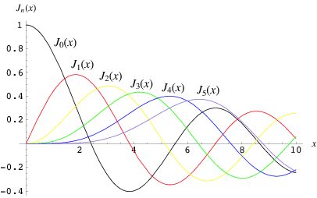
Consider eq. (4) along with the boundary condition φ(R,t) = 0
We get R that satisfies this condition because J₀ has (infinitely many) positive zeros (shown in the Bessel function graph) , s = α₁, α₂, … with numerical values
Bessel’s function of the 1st kind
https://electronics.stackexchange.com/questions/73334/using-bessel-function-graph-to-finde-out-side-bands

Slide 9
Due to multiple values of argument that give J₀ = 0, a modification can be made as follows
Hence, the functions
are solutions of eq. (2) that are zero on the boundary circle r = R.
This suggests that the solution for linear ODE eq. (1) can be given as
Where

Slide 10
A complete solution for wave function of a circular membrane
Therefore, the wave function with a radial symmetric for a circular membrane can be written as φ(r,t) =R(r)T(t).
The vibration pattern of the circular membrane is described by the radial function R.
For example : m = 1, and 0 < r < R, φ becomes a maximum value when r = 0 and the function gradually reduced to zero; i.e. J₀(α₁) = 0 at r = R,
m = 2 and 0 < r < R, φ becomes a maximum value when r = 0 and the function becomes zeros twice; i.e. J₀(α₁) = 0 and J₀(α₂) = 0 at r = R. Under this condition, there is one nodal line.

Slide 11
Normal modes of the circular membrane in the case of vibration independent of angle
http://zeta.math.utsa.edu/~gokhman/courses/mat3623/Membrane.pdf

Slide 12
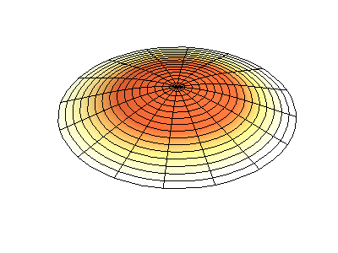
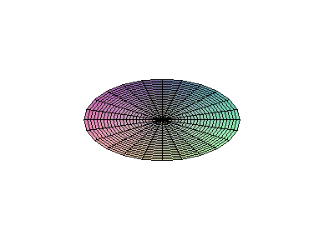
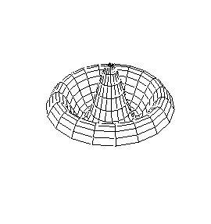
Vibration pattern of circular membrane
m =1
m =2
m =3
https://scilearn.sydney.edu.au/fychemistry/SupCourse/Circular%20Membrane.htm
http://physics.usask.ca/~hirose/ep225/animation/drum/anim-drum.htm
http://archive.is/YbBi

